Slide 1

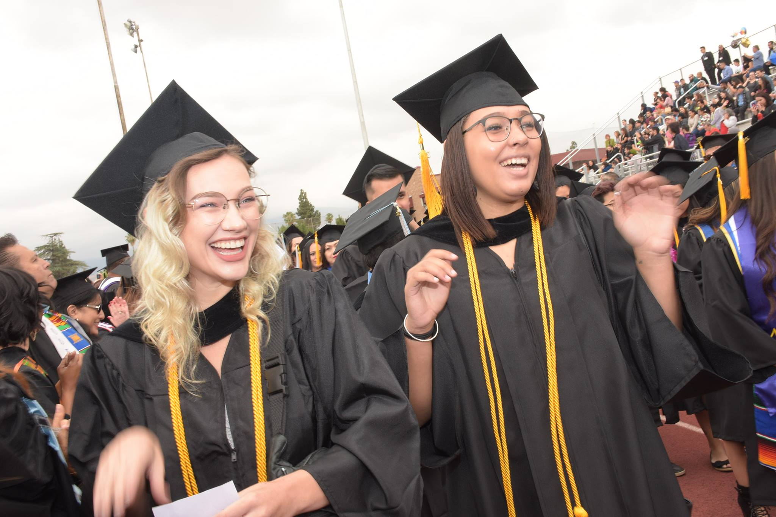
San Bernardino Community College District
SBCCD Journey to Sustainability and Zero Net Energy
Updated 05/08/2019
Notes:
This is a draft. I will be including slides related to campus sustanability

Slide 2
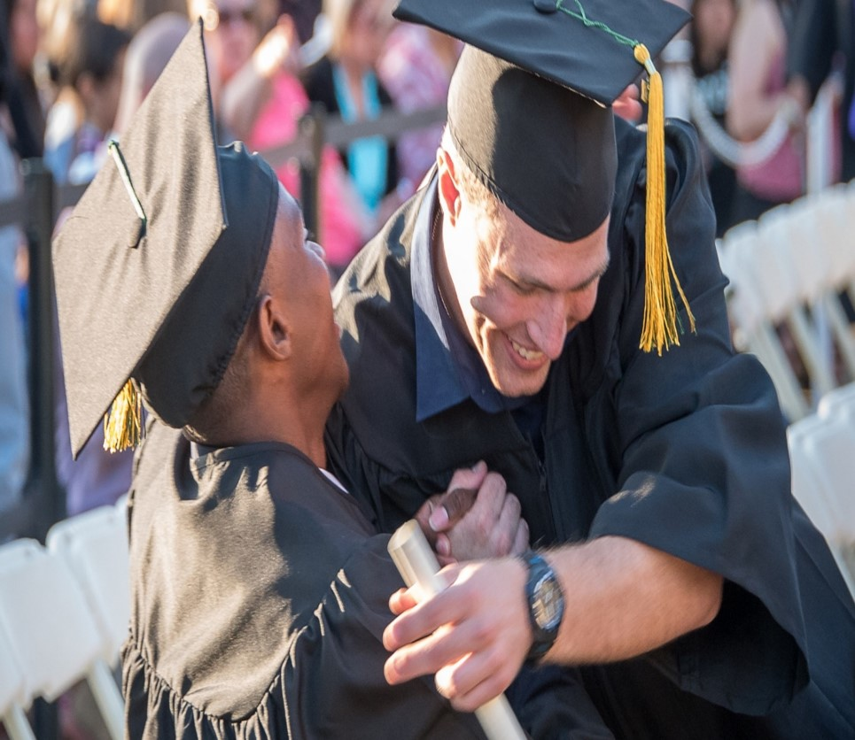
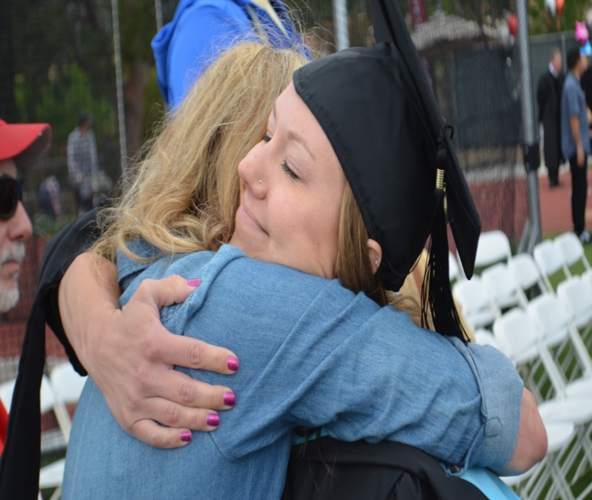
ZNE Pilot Program Highlights
Who is SBCCD
Meet ouR team
Prop 39 ZNE Pilot Project
Review of Cadmus Analysis
Cost of ZNE
ZNE Pilot Program
Zero Net Energy Approach
Implementation of Measures
LED Lighting Retrofit
Tubular Skylight
HVAC Upgrade
Tank less water heater
Solar Shading
What’s next

Slide 3
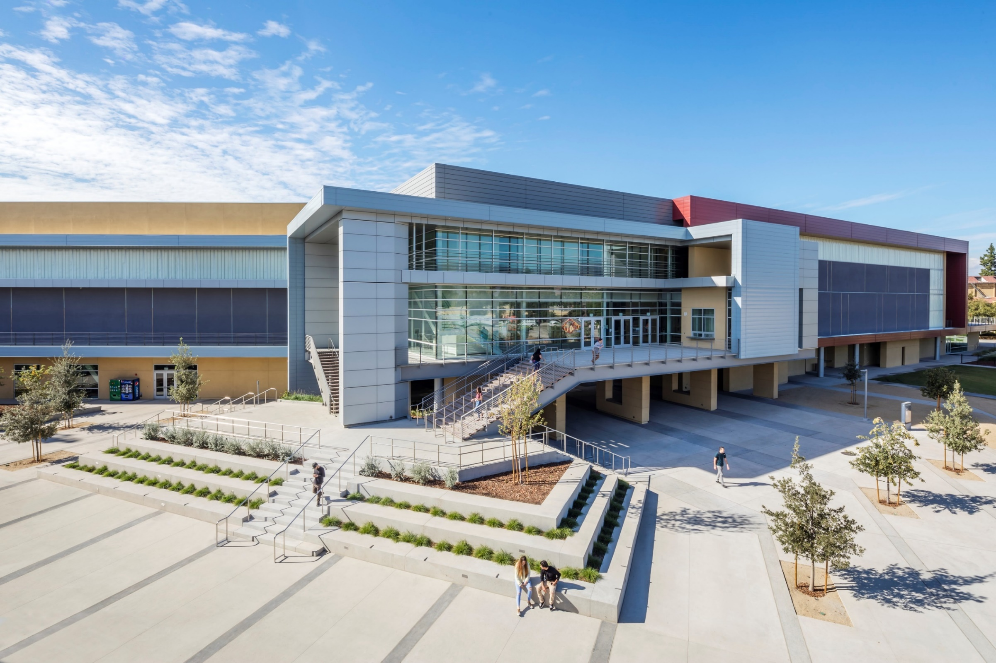



Who is SBCCD?
1 Out of 72 Community College Districts in State of California
2 Out of 114 Campuses of CCD system
4 Million people within its geographical region
22 Cities and Communities within its geographical region
25,000 students served annually
1 Million square-feet and 57 facilities district-wide
$621,800,000 Dollar contribution annually for regional economic impact

Slide 4

Initial Sustainability Thoughts
Green Buildings (Leadership in Energy and Environmental Design)
Climate/Greenhouse Gas Emissions (Presidents’ Climate Commitment)
Energy Conservation and Alternative Energy
Academic Instruction and Workforce Training
Funding (Internal and External Sources)
Business Practices and Policies
Communication and Outreach
Water Conservation
Waste and Recycling
Transportation

Slide 5
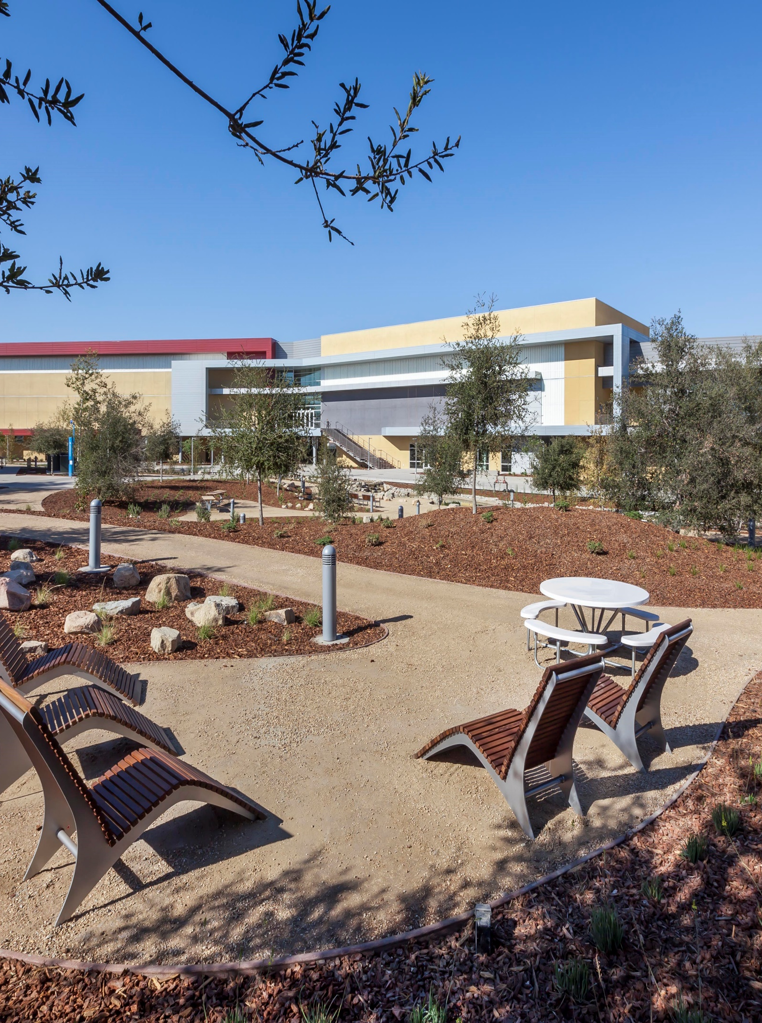
Sustainability is a Culture
2010 Participation @ American college and university presidents’ climate commitment
2010 Board policy (3580)
2011 Committee membership
2012 Sustainability plan adopted. Long term dedication & commitment by BOT, chancellor, colleges presidents, community stakeholders
2012 Alternate energy conception plan
2012 Energy conservation plan
2012 Behavioral changes – educational component
2010 - 2017 (10) LEED Certified projects districtwide
2013 SBVC central plant + CHC solar farm
2016 CHC recyclable water for campus irrigation
2017 - 2022 Facilities master plan
2018 Sustainability & Energy Manager
2018 - 2019 Integrated energy & sustainability master plan

Slide 6
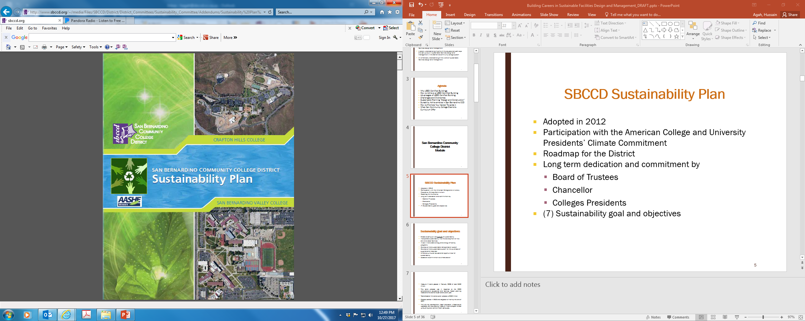
7 Goals of Sustainability Plan
Create a campus-wide culture of sustainability
Incorporate sustainability into the development of new and renovated facilities
Invest in renewable energy and energy efficiency programs
Develop a more sustainable transportation system
Develop a more sustainable system for the purchase of supplies and materials
Enhance curricular educational opportunities for sustainability
Establish a commitment to climate action

Slide 7
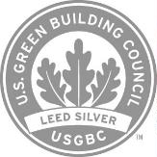
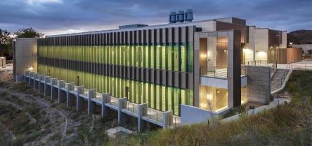
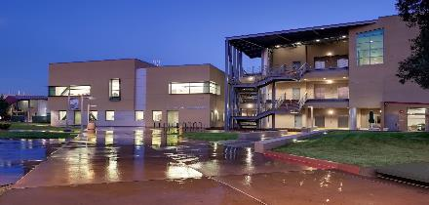

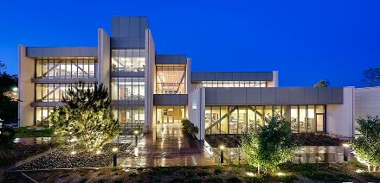
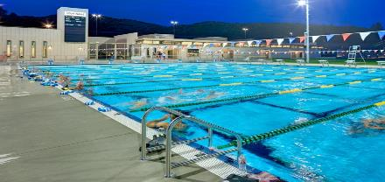
Better Sustainable Colleges Delivered
CHC Science Facility 2015
(New Construction)
SBVC Chemistry Physical Science 2010 (New Construction)
CHC Learning Resource Center 2012 (New Construction)
CHC Aquatic Center Facility 2011
(New Construction)

Slide 8
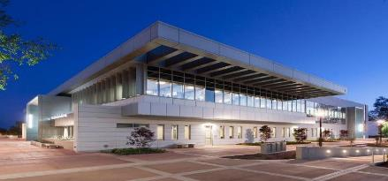


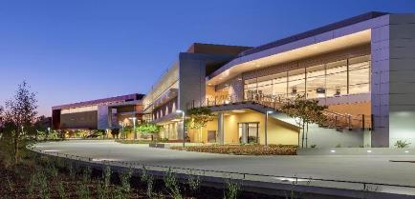
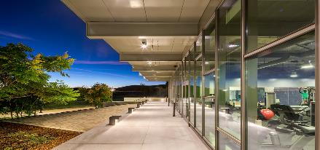
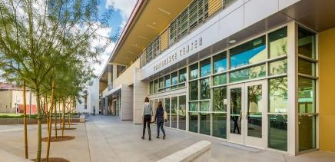
Better Sustainable Colleges Delivered
CHC Student Center Facility 2015 (New Construction)
SBVC Gymnasium & PE Facility 2016 (New Construction)
CHC Physical Education Facility 2014 (New Construction
SBVC Business Facility 2014 (Major Renovation)

Slide 9
Meet Our Team – SBCCD Visionaries
Board of Trustees:
John Longville, President
Dr. Anne L. Viricel, Vice President
Joseph Williams, Clerk
Gloria Macias Harrison, Member
Dr. Stephanie Houston, Member
Frank Reyes, Member
Dr. Donald L. Singer, Member
Autumn Blackburn, Student Trustee
Elijah Gerard, Student Trustee
SBCCD Leadership:
Bruce Barron, Chancellor
Jose Torres, Executive Vice Chancellor
Diana Rodriguez, President, SBVC
Dr. Kevin Horan, President, CHC

Slide 10
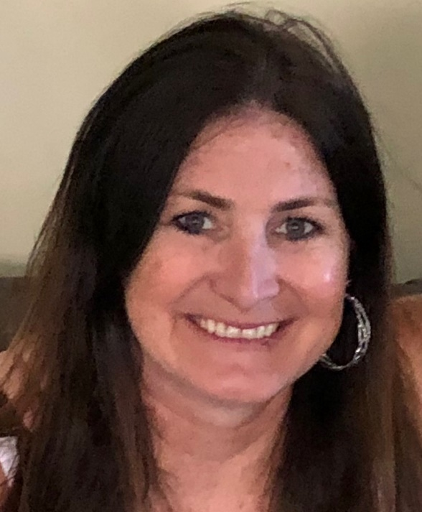
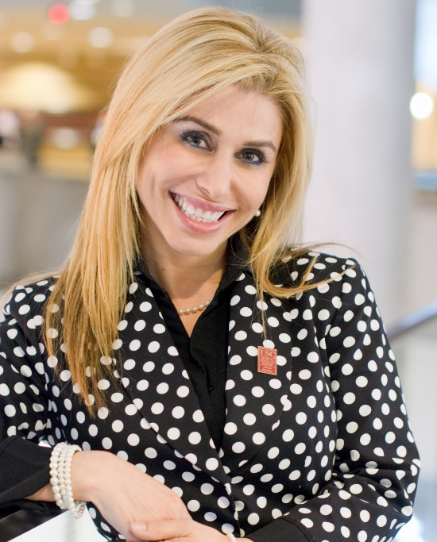
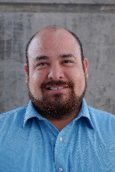
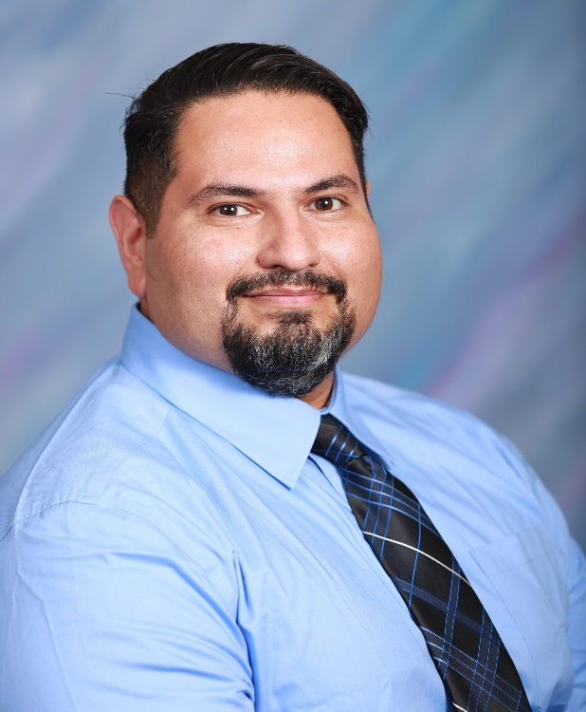
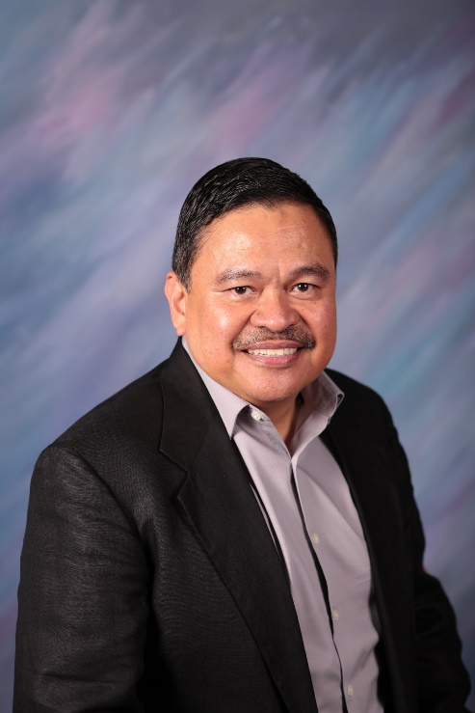
Meet Our Team – SBCCD Implementation and Utility Partners
Utility partners:
Southern California Edison (SCE)
Southern California Gas Company (SCG)
Project inspector and Contractors
Knowland Inspection - Dave Fenderson
Three peaks corporation/Titan electric (electrical/lighting contractors)
SDSTATURE (Tubular Daylighting Device Contractor)
LA Air-conditioning (Mechanical Contractor)
Sunbelt controls (HVAC Direct Digital Controls Contractor)
Lemay Construction (Plumbing Contractor)
Awesome Blinds (Automatic Shading Contractor)
Farrah (SBCCD)
Lisa (SCE)
Gustavo (SCG)
Robert (SCE)
Efren (SCE)

Slide 11
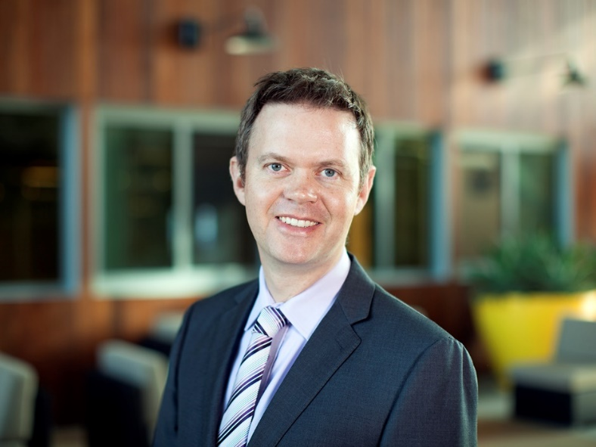
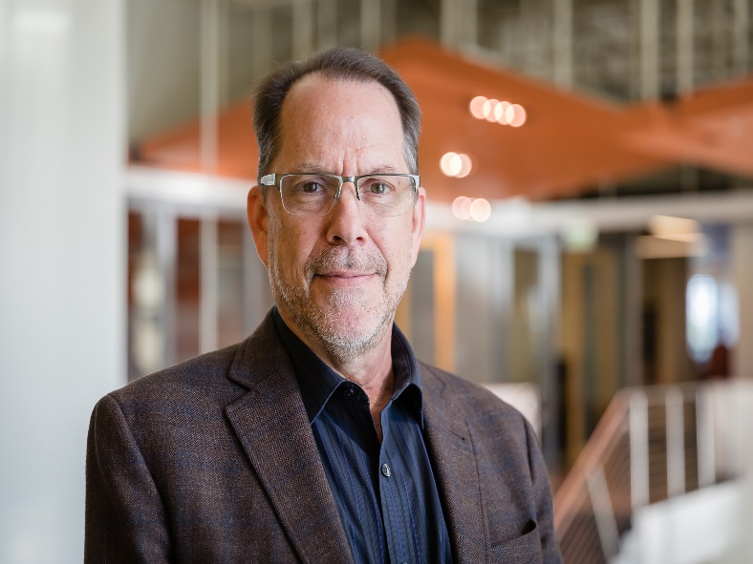
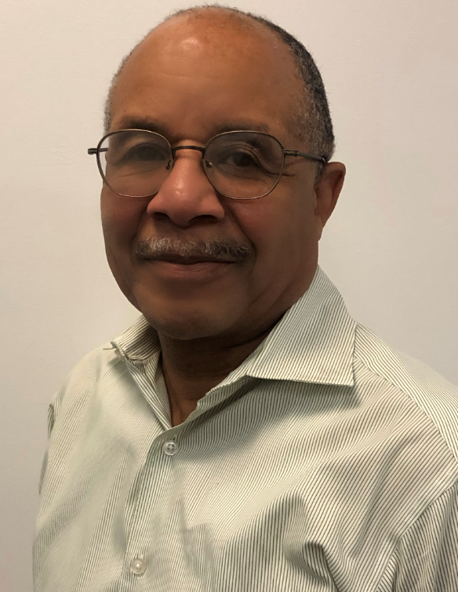

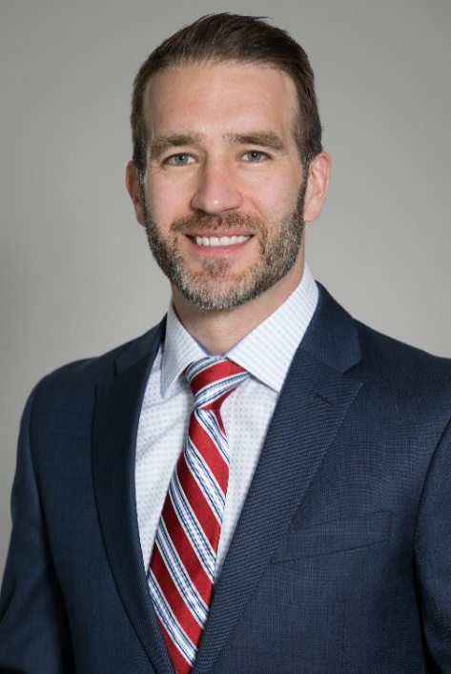
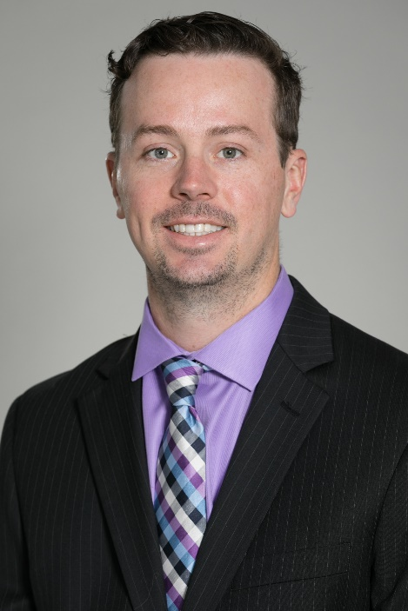
Meet Our Team – Technical Advisors
SBCCD’s Technical Consultants:
ARUP – Sustainability and Energy consultants
HMC Architects
ENGIE (Mechanical Consultant)
Martin (ARUP)
Ken (HMC)
Gregory (Engie)
SCE’s Technical Consultants:
Cadmus – project design report consultant
Agile environments (Cadmus lighting specialist sub-consultant)
Noresco – M&V and final report consultant
Sahar
(Cadmus)
Rick
(Noresco)
Andrew
(Noresco)

Slide 12








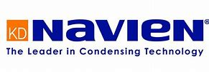


Meet Our Team – Manufacturing Partners
Manufacturing partners:
SunPower (Solar PV system)
Enocean (Wireless Controls)
LA lighting mfg. Co. (LED Retrofit Kits & new LED lights)
Solatube (Tubular Daylighting Devices)
Integrated comfort Inc. (A/C Unit Pre-coolers)
Automated logic corporation (HVAC Direct Digital Controls)
Trane air-conditioning co. (District office ultra high efficiency A/C units)
Sigler (Carrier ATTC high efficiency A/C units)
Mechoshade and Thermeshade (Automatic Shading Devices)
Navien (Tankless Instantaneous Gas Water Heater)

Slide 13
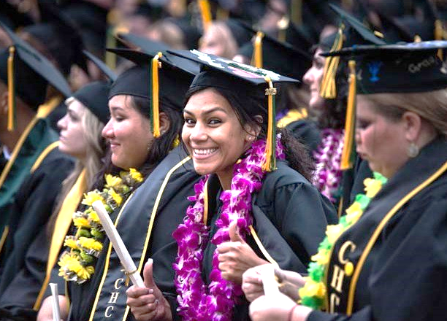
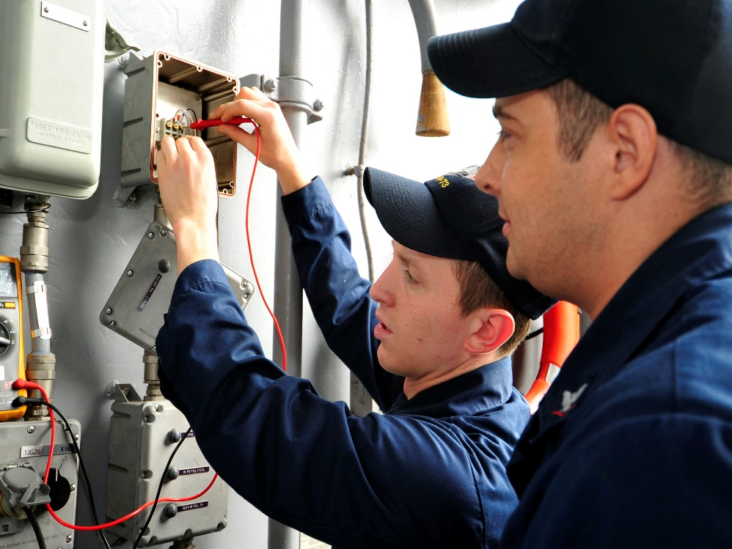
Prop 39 ZNE Pilot Project
Learning Objective 1:
The pilot program aims to establish that ZNE retrofits of schools is feasible across California.
Learning Objective 2:
All stakeholders involved in this pilot program are receiving an in-depth training on ZNE design and implementation, new and advance technologies, and the information gathered on any challenges on building to a ZNE level, is the basis of case studies being developed for school district education.
Learning Objective 3:
The pilot program will provide the basis of larger scale implementation of ZNE concept at schools and community colleges and it will make schools and communities stronger, resilient and energy independent.
Learning Objective 4:
Gather information about the current incremental cost of ZNE for school districts, and where these costs can be driven down, allowing district to redirect money for utility bills to classroom
Notes:
Add for learning lesson #2: This project presented unique challenges as the energy efficiency measures proposed would need to be implemented during normal working hours, within a very aggressive time period to complete and strict budget constraints.
Program Goals
ZNE projects are part of California Public Utilities Company’s (CPUC) Proposition 39 ZNE for Schools Pilot Program. Funds for Prop 39, The California Clean Energy Jobs Act, are helping schools across California with the state’s goals to reduce energy use and greenhouse emissions. ​
​
Leverage Prop 39 funds​
Retrofitting “existing” buildings in public schools & community colleges​
Establish “Proof of Concept” of feasibility across California​
Document findings & Best Practices​
Future Program Development
Prop 39 ZNE Value to Schools
Socialize awareness to stakeholders
District staff members, teachers, students, parents, & community
Design Assistance
Training
Implementation & on-going maintenance of these retrofits

Slide 14
Pilot Recommendations by CAMDUS

Slide 15
Pilot Implemented Measures

Slide 16
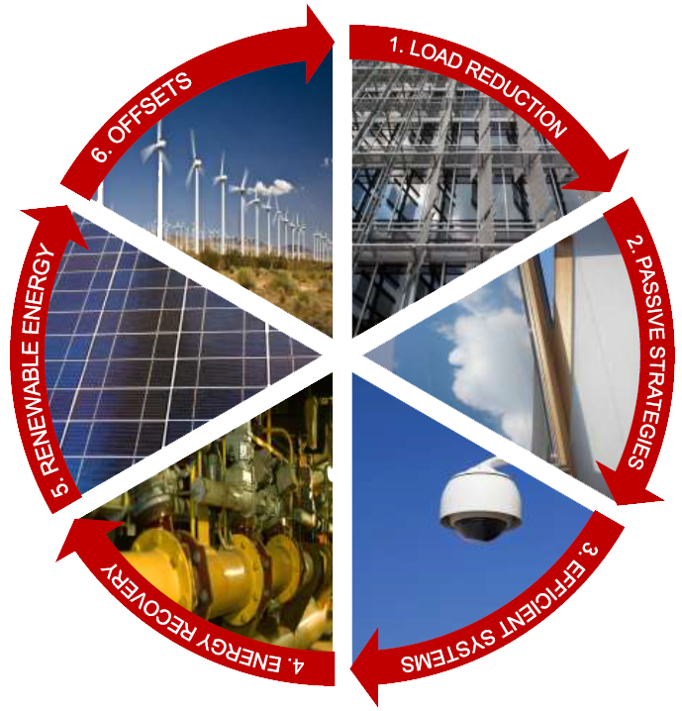
Zero Net Energy Approach
EEM-9
Automated Shading
EEM-10
Light Tubes
Photovoltaics
EEM-6
Gas Water Heater
EEM-5
Convert to VAV
EEM-7
Plug load management
EEM-3
Evaporative Condenser
EEM-7
LED Lighting
EEM-2 / 4
New RTU’s

Slide 17
Zero Net Energy Approach

Slide 18
Zero Net Energy Approach
EEM’s

Slide 19
Zero Net Energy Approach

Slide 20
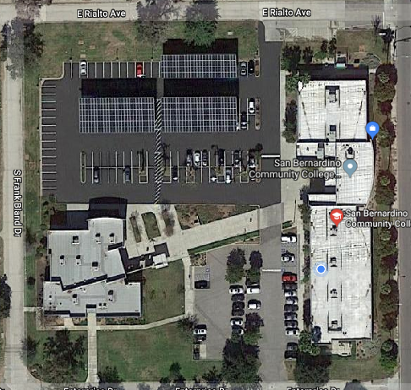
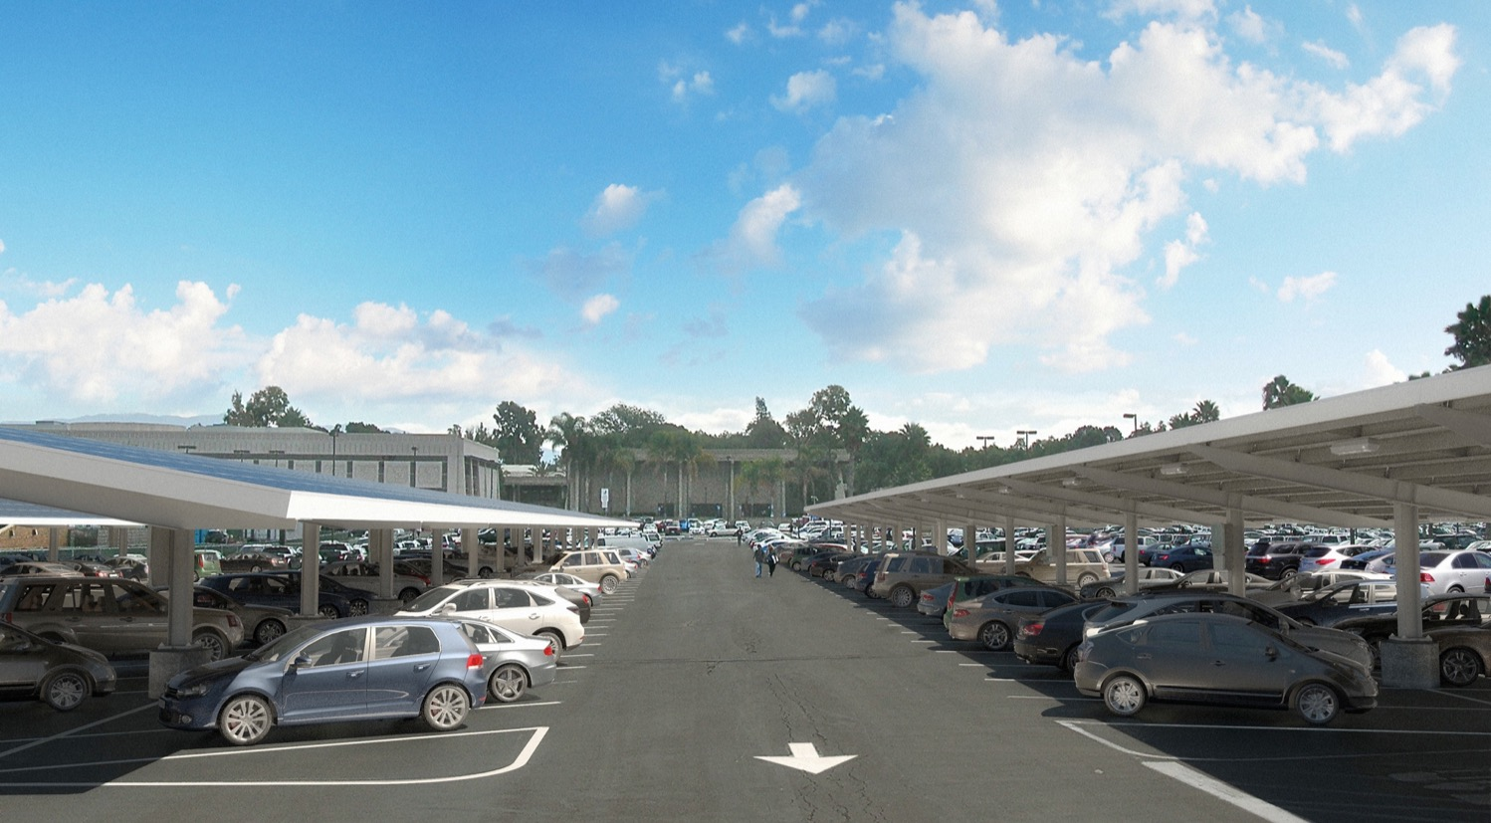
Solar PV and EV Charging Stations
174 kW Carport Photovoltaic System
Provided by Sunpower
Added benefits of keeping cars cool(er) and reduced heat island effect from asphalt
Operational since Feb 2018. Performance so far meeting expectations

Slide 21
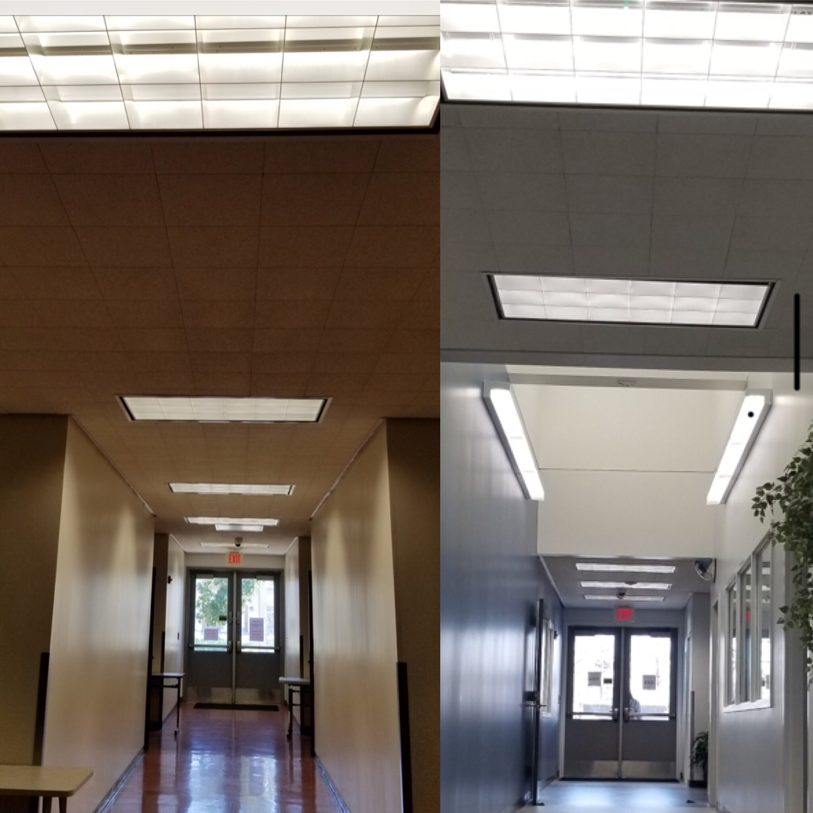
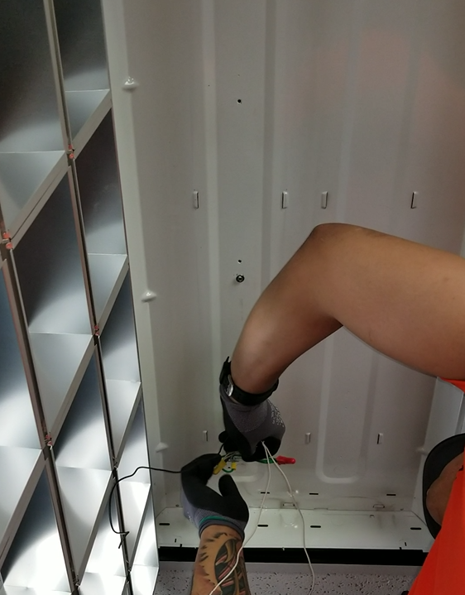
LED Lighting Retrofit
Retrofit Solution
LA Lighting & EnOcean Controls
Integration with Solar Tubes
Parabolic Troffer

Slide 22
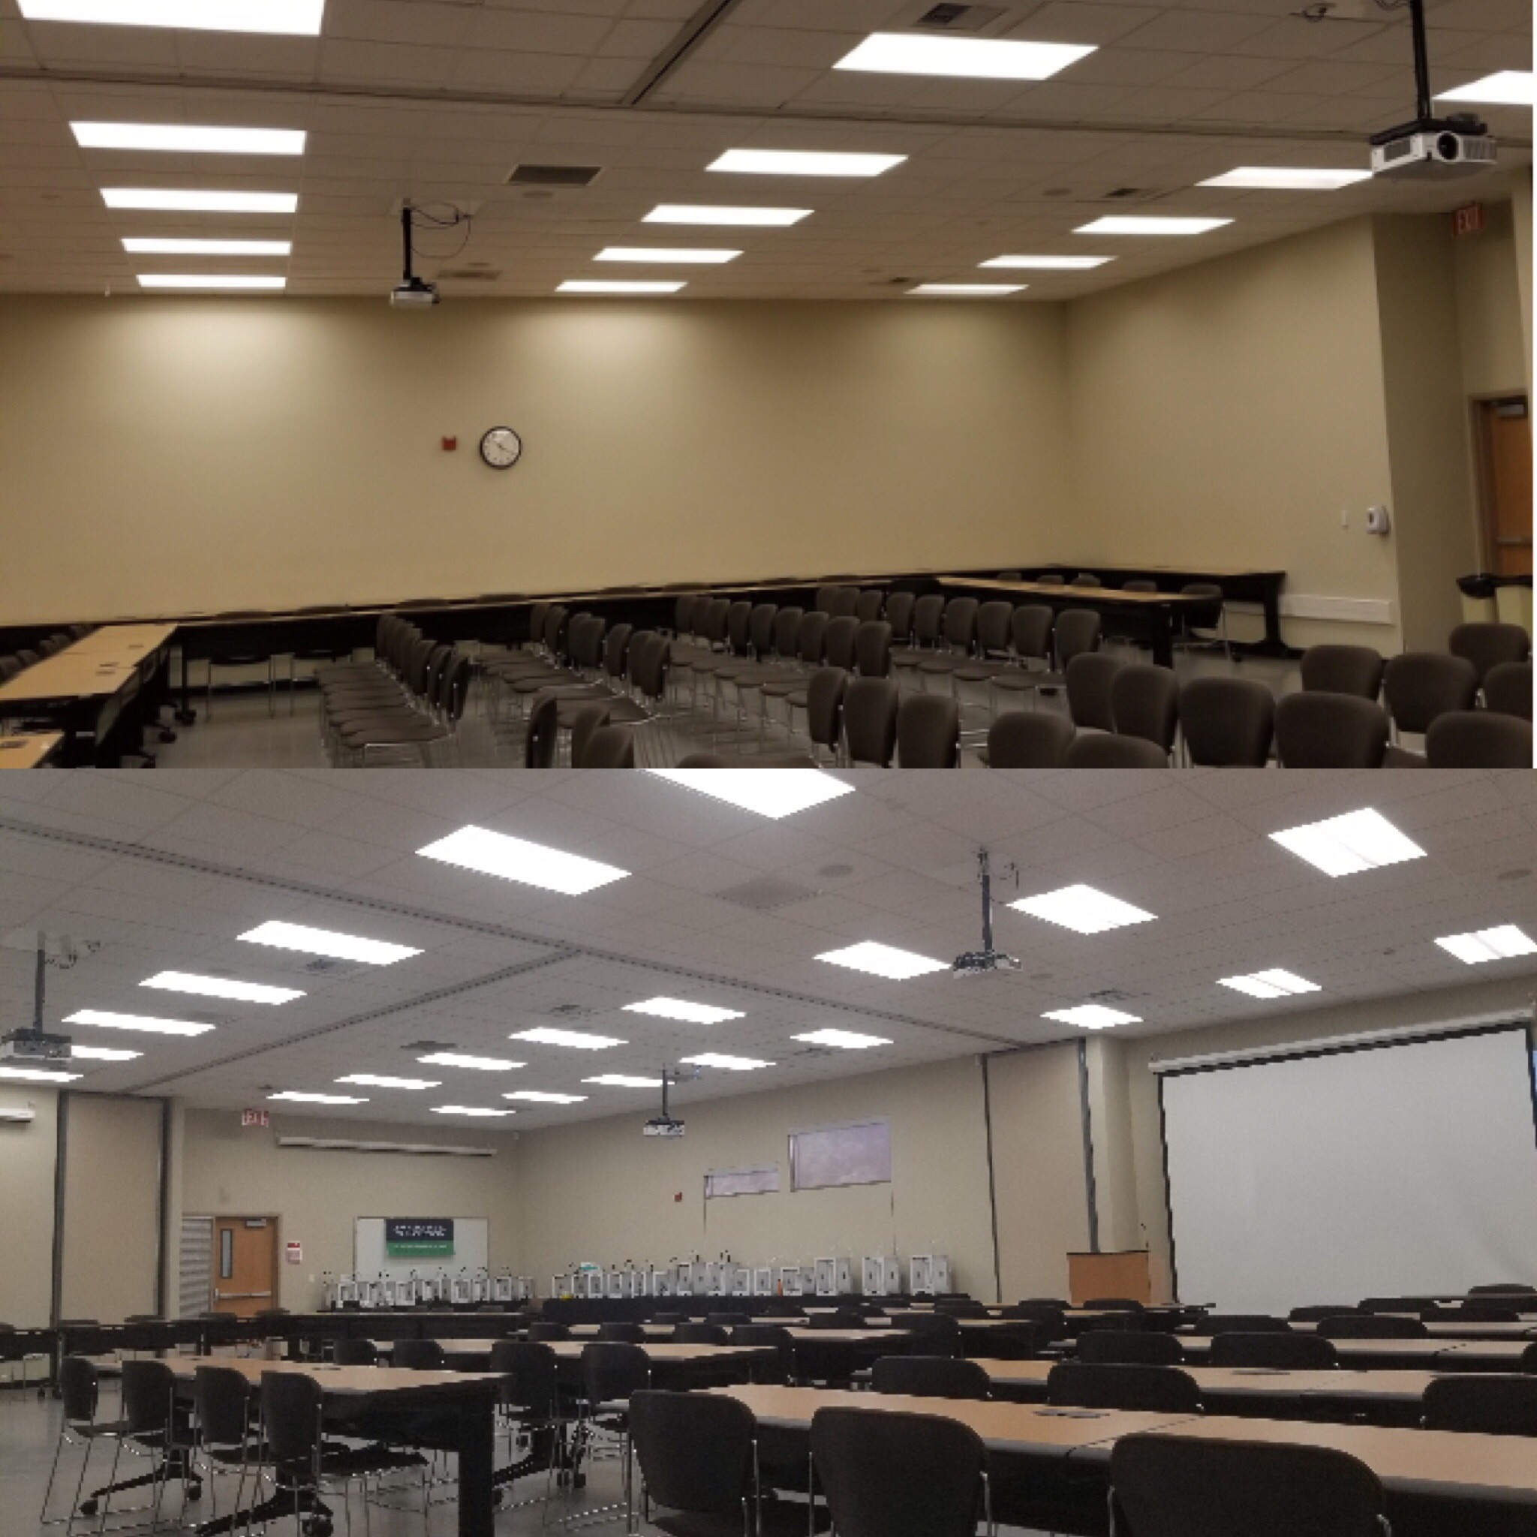
LED Lighting Retrofit
Executive
Training Room

Slide 23
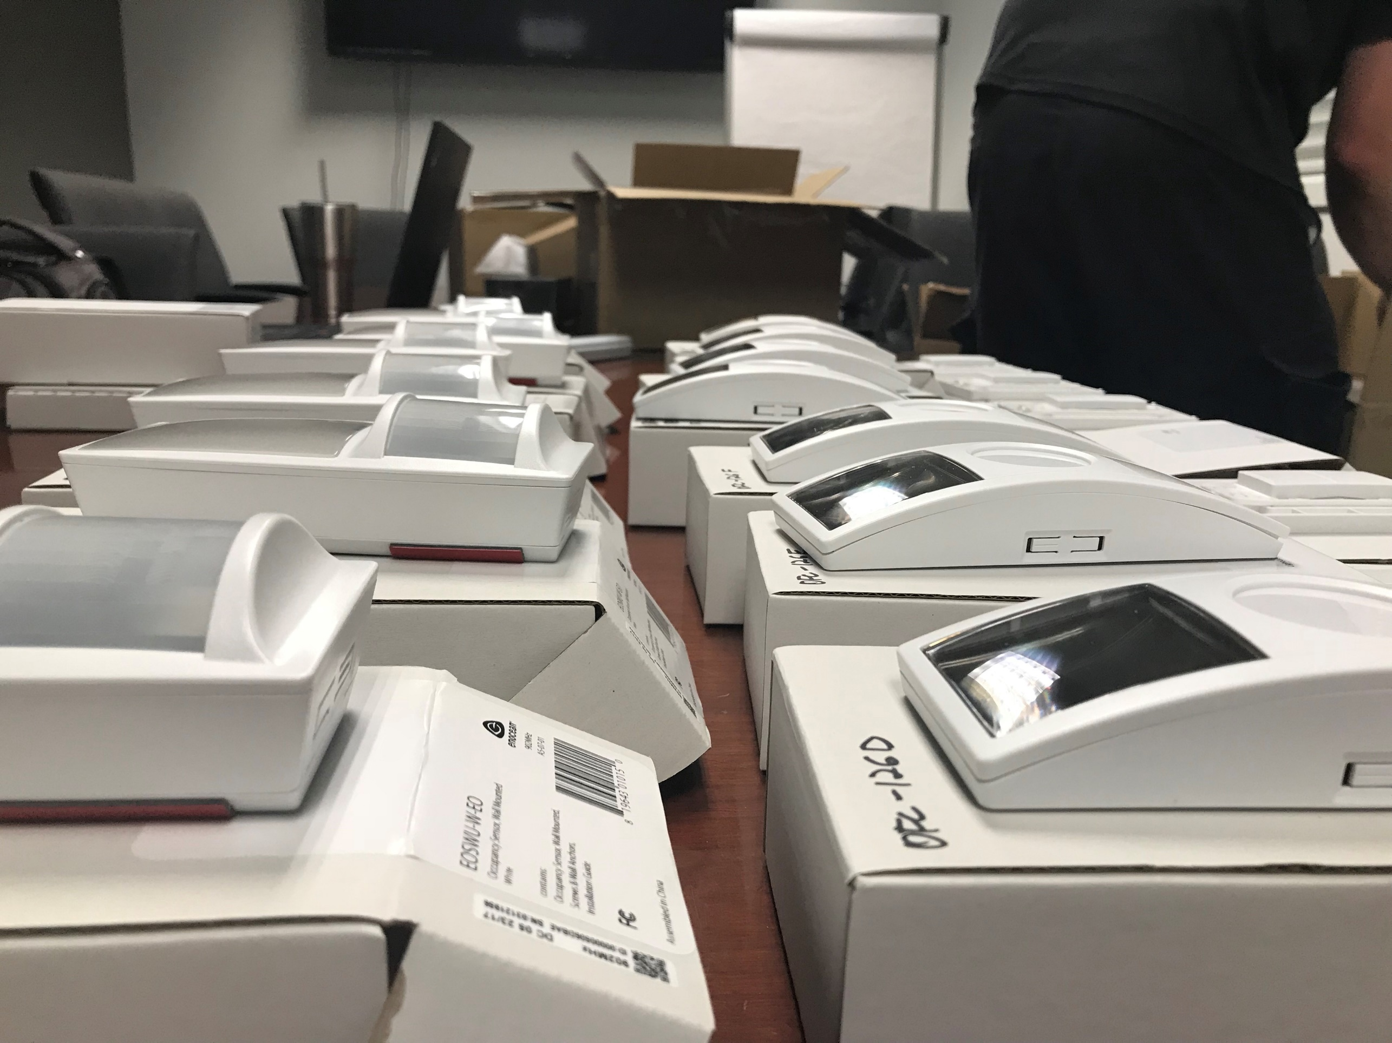
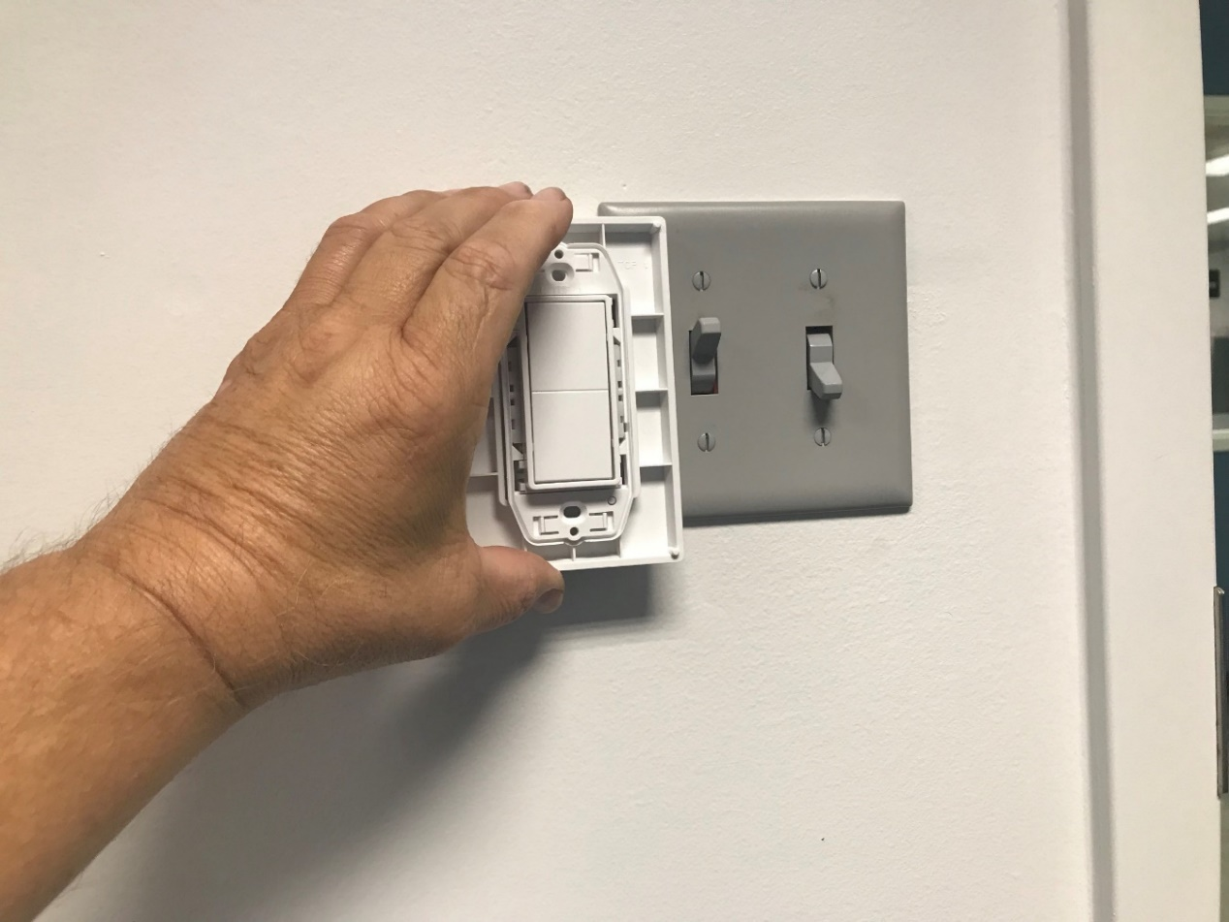
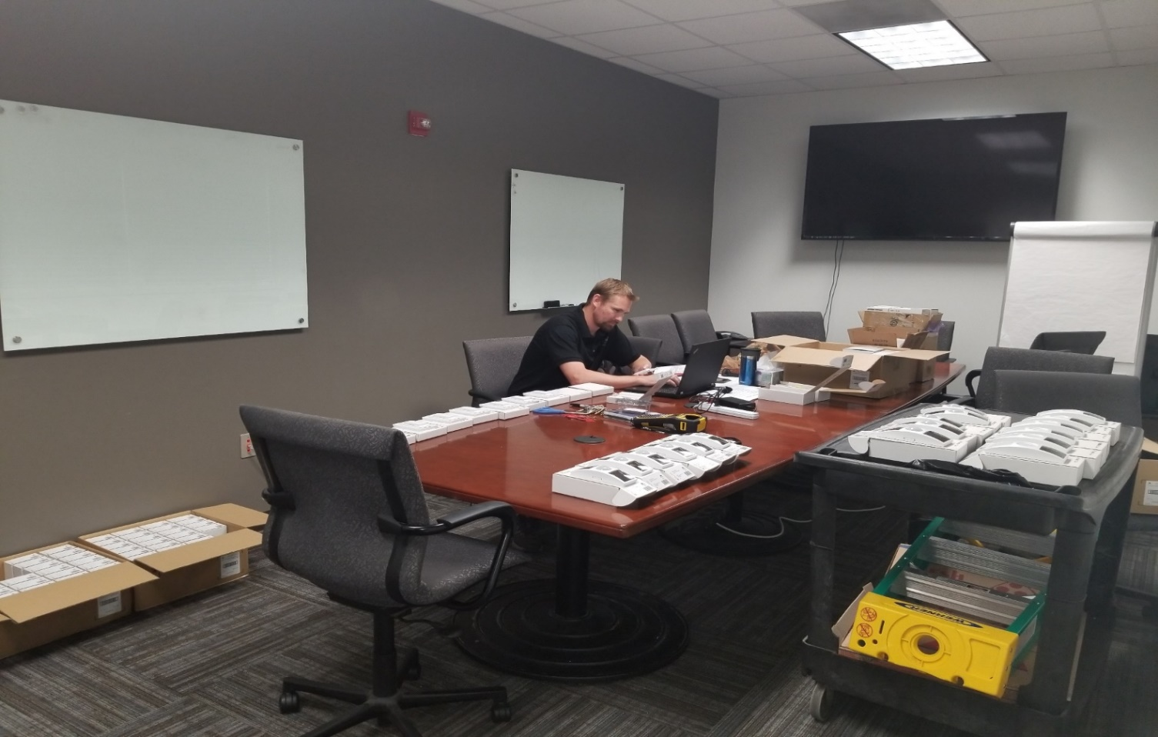
LED Lighting Retrofit
EnOcean
Controls

Slide 24
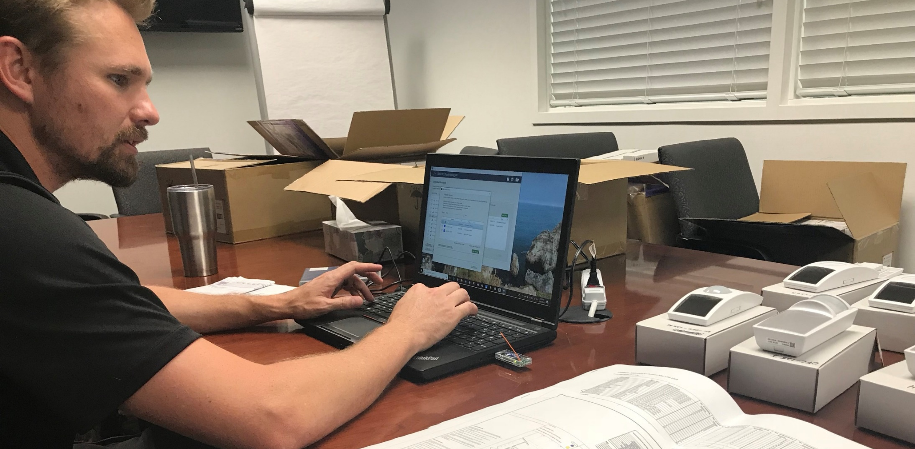
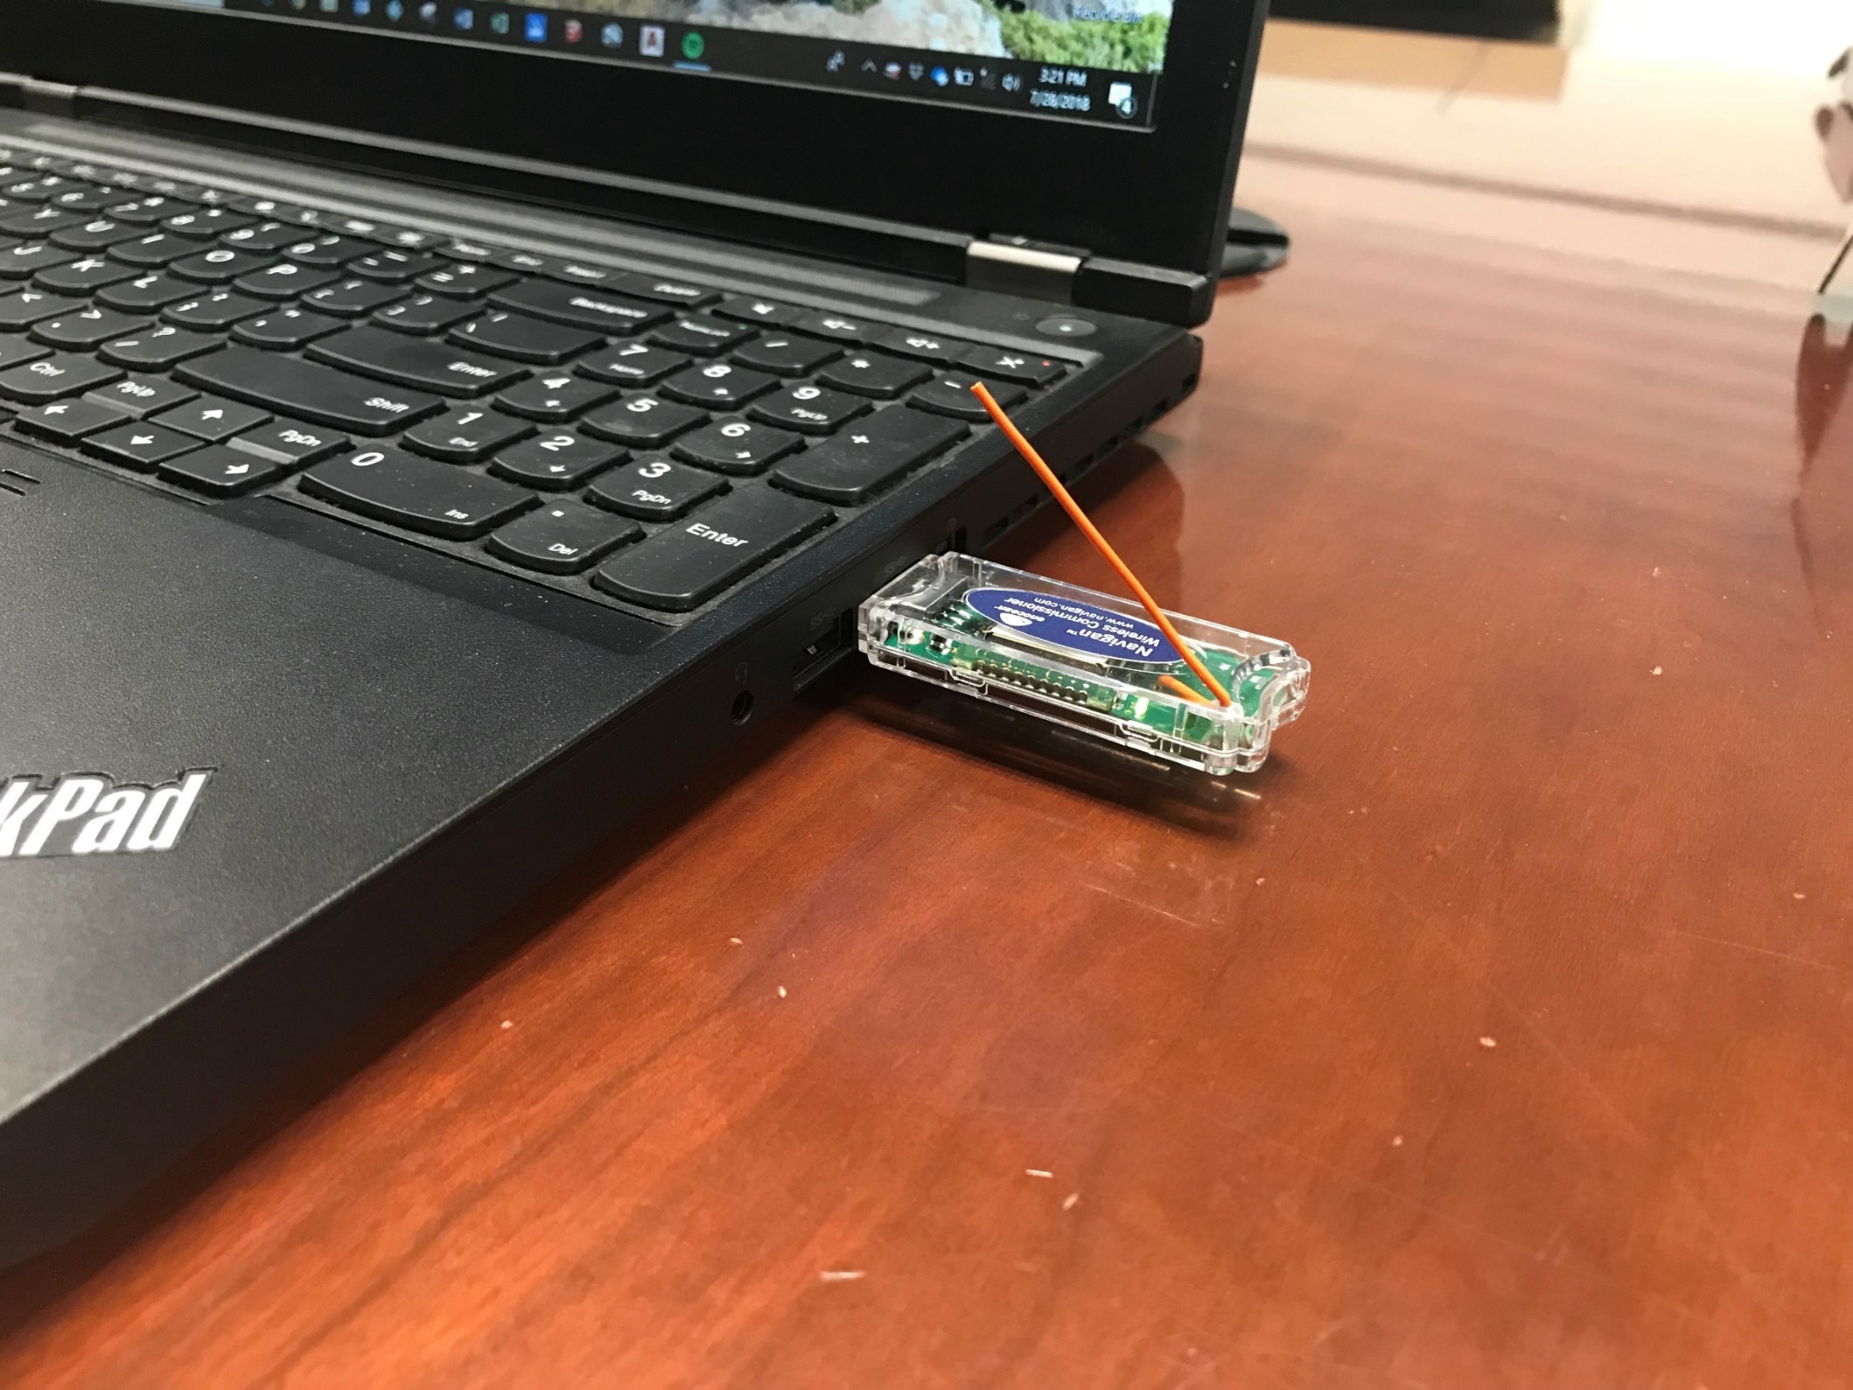
LED Lighting Retrofit in Closeout Phase
EnOcean
Commissioning

Slide 25
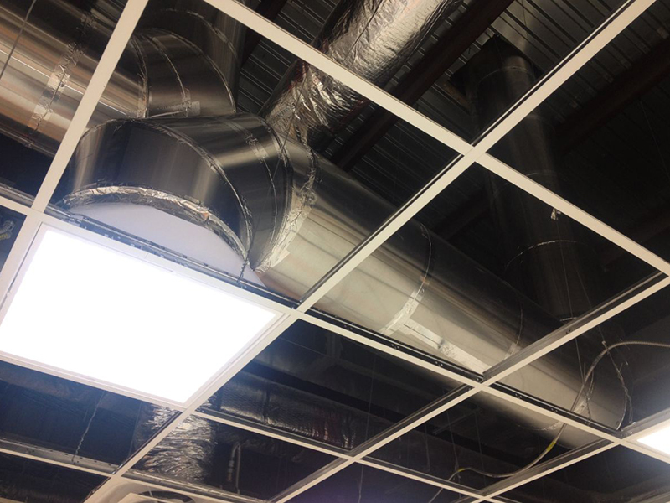
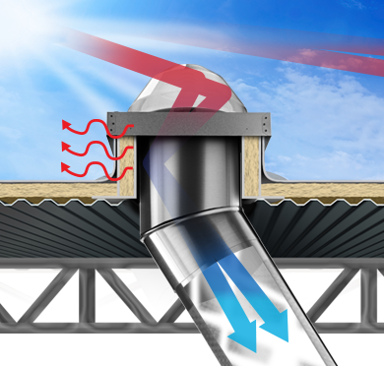
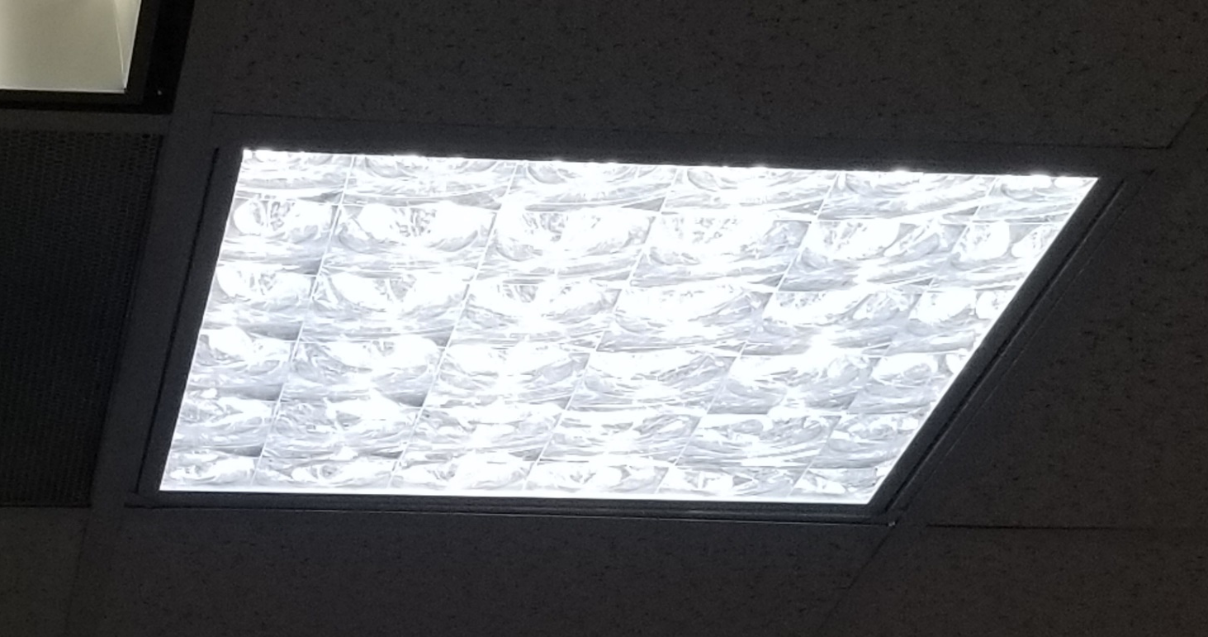
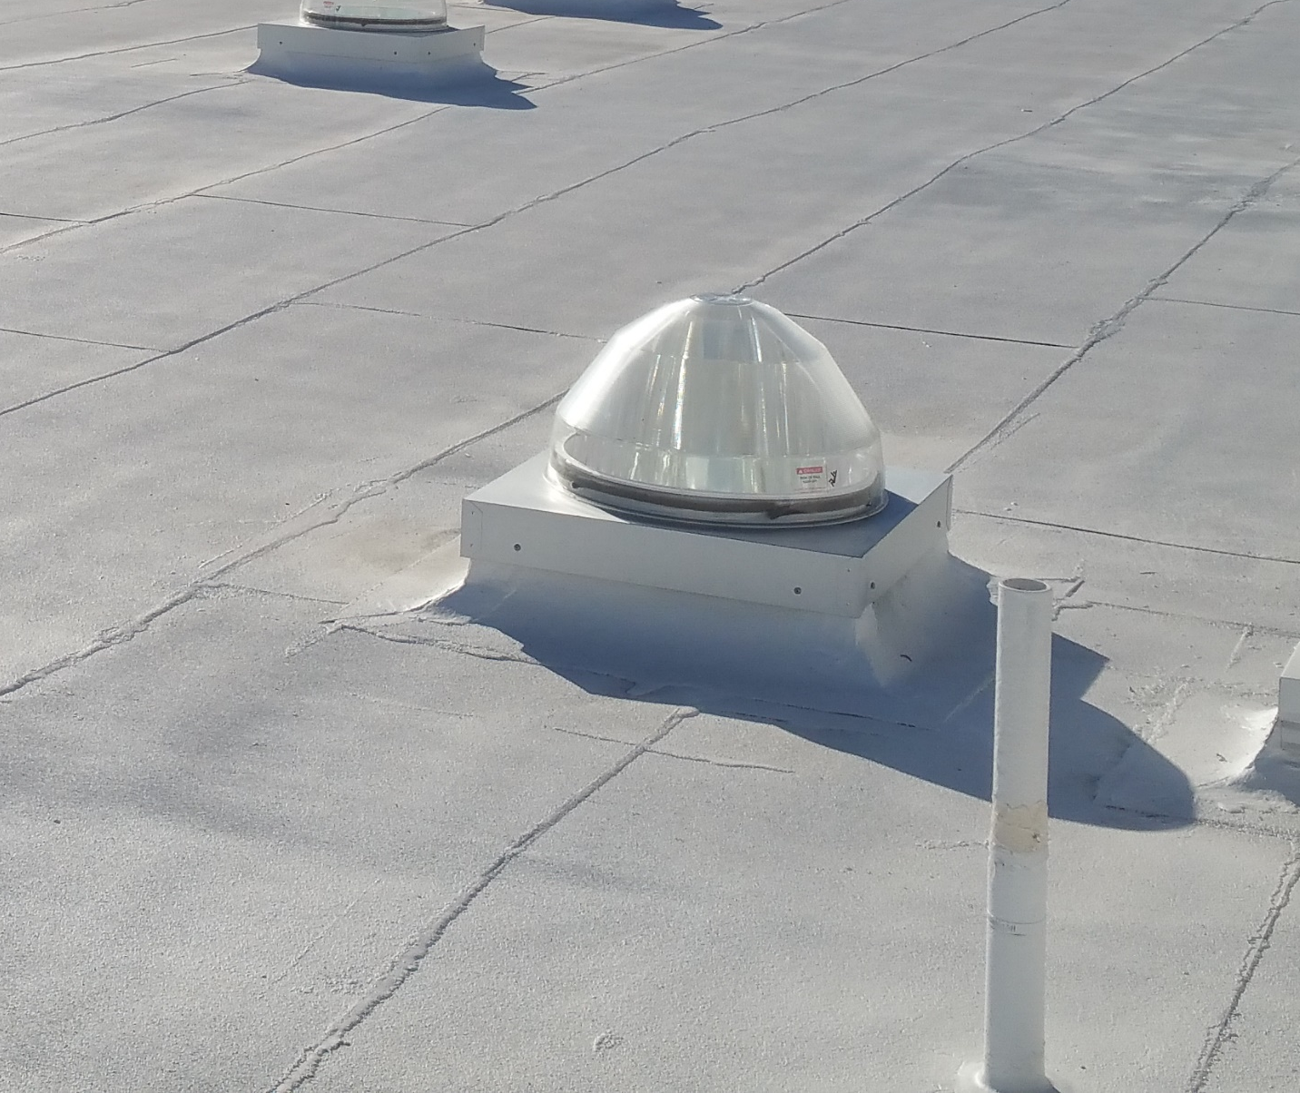
Tube Skylight Project

Slide 26
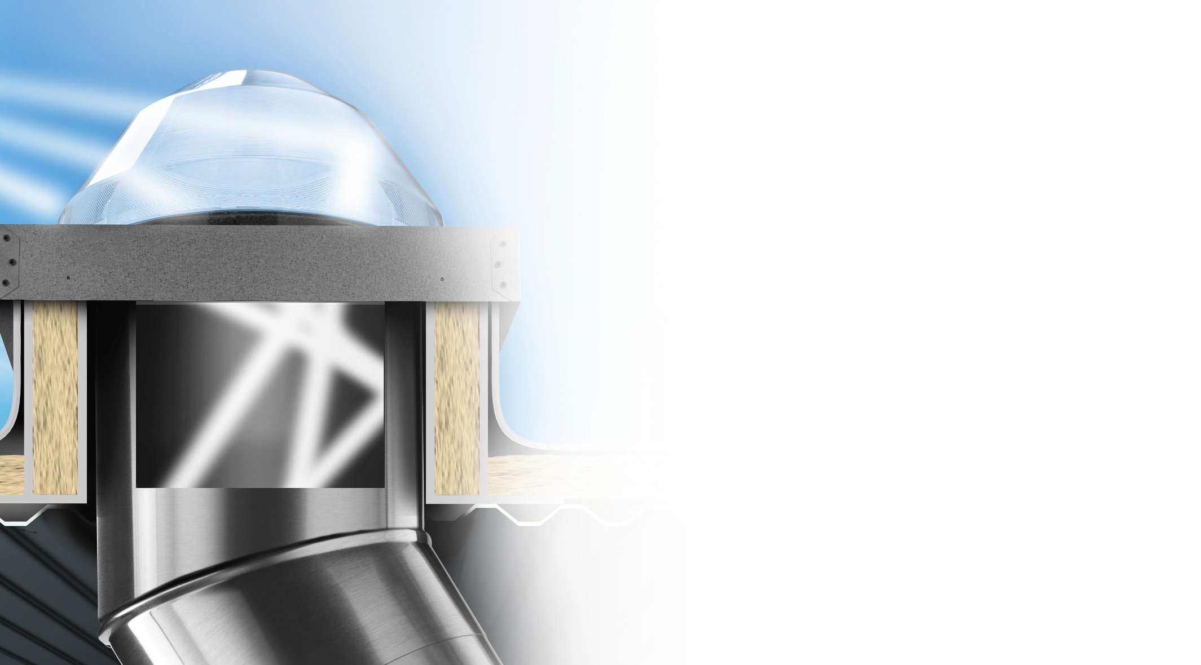





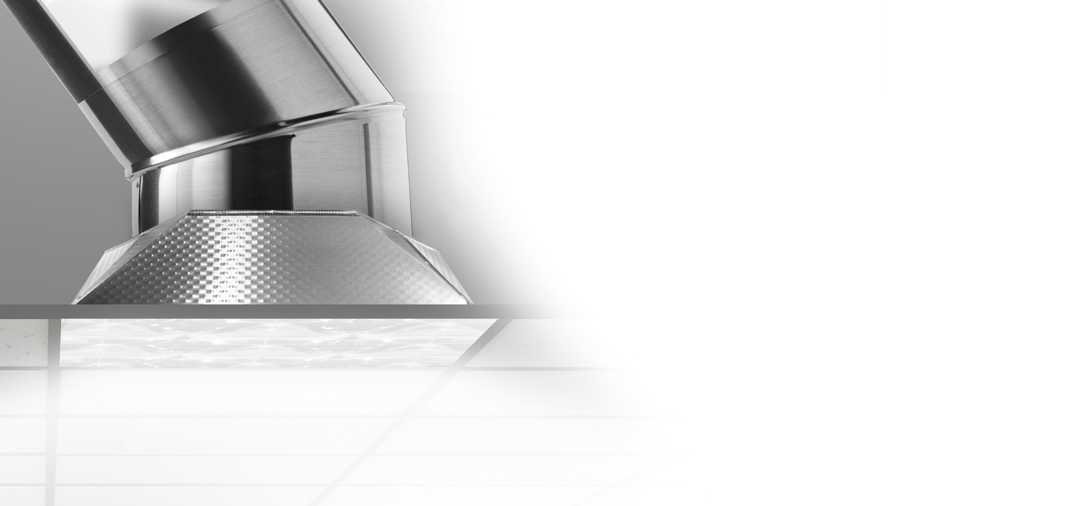
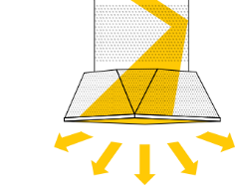

Transfer
Capture
Raybender® 3000
A patented daylight-capturing dome lens that redirects low-angle sunlight for maximum light capture.
LightTracker® Reflector
An innovative in-dome reflector that maximizes the capture of low-angle winter and late-day sunlight.
Spectralight® Infinity
Tubing that transfers maximum sunlight over long distances and up to 90 degree turns.
SoftLight™
Textured sections of
Spectralight Infinity tubing
and metal transition boxes
that diffuse and soften the daylight.
Deliver
Engineered Light Diffusion
Optical lenses and lighting control options that provide visual comfort and deliver superior diffusion.
Daylight Dimmer
0-10 low voltage dimer
adjusts daylight levels,
anywhere from full bright to
almost completely dark.

Slide 27
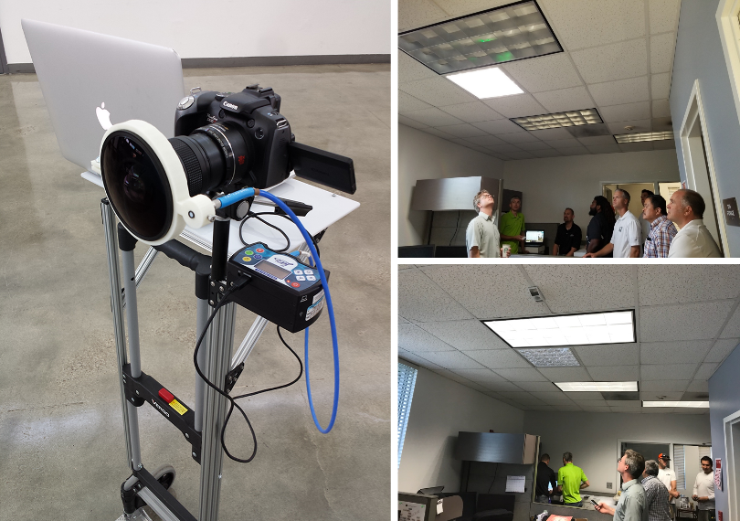
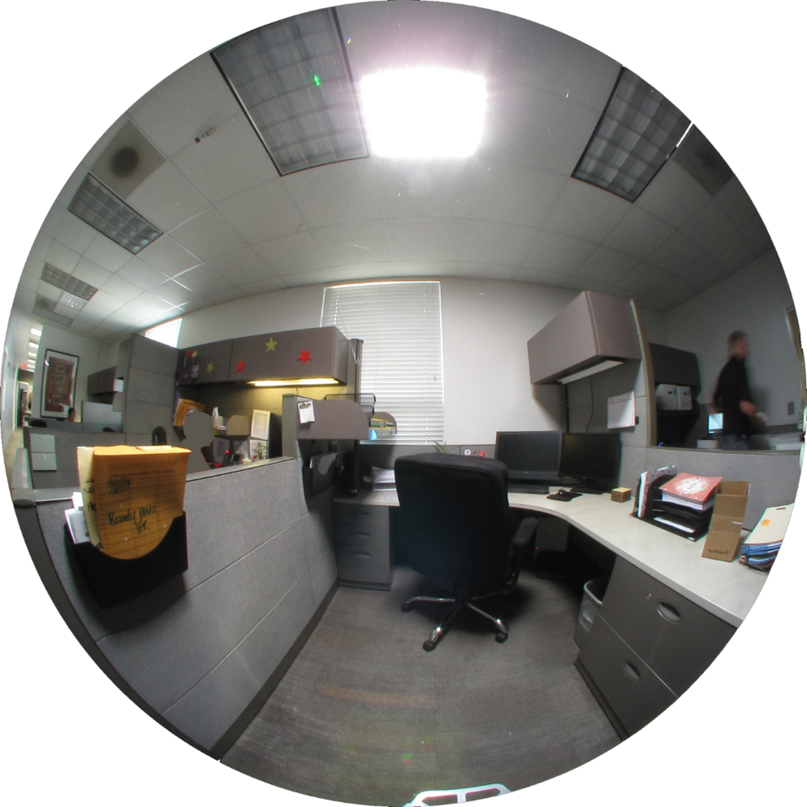
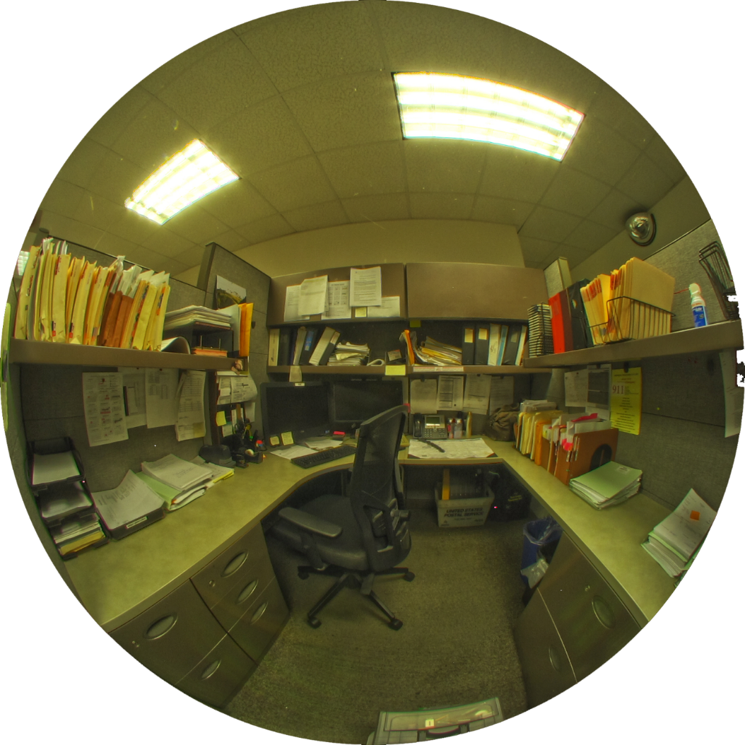
Spectrometer Spot Measurement
269 EML
Just SOLATUBE
98 EML
Old Fluorescent
Notes:
Now, let’s take a look at the Solatube (with the LEDs OFF) compared with the old fluorescent lighting condition
Note that this comparison is based on two spot measurements taken in different cubicles and slightly different view points. But the conditions are similar.
Just SolaTube
Where this measurement was taken, 269 EML is achieved with just the daylight coming from the SolaTube.
This measurement supports the design goal that workstations near Solatubes can be primarily lit with daylight during daylight hours, (even with the blinds fully closed).
Old Fluorescent
Compared with the old fluorescent light spectrum, which has sharp spikes, the daylight spectrum is broader and more even.
The daylight source delivers nearly three times more Equivalent Melanopic Lux (EML), which leads to greater potential for circadian stimulus and alertness

Slide 28
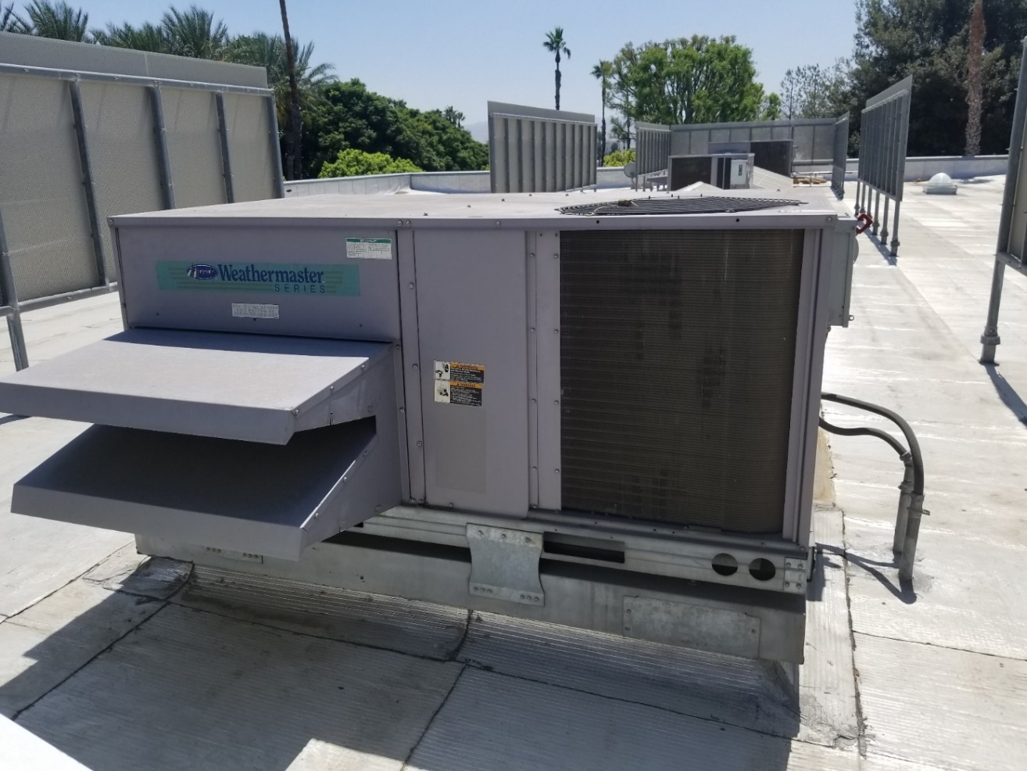






HVAC Replacement
HVAC - Demolition and replacement of five existing rooftop package constant volume units with new ultra high efficiency variable speed air conditioning units and three existing rooftop package constant volume units with high efficiency variable speed air conditioning units.
Variable Air Volume (VAV) - Provided new variable air volume boxes for training rooms.
Controls - The existing building energy management system will be upgraded.
CO2 sensors were added for demand control ventilation.
Notes:
Precoolers need to be added

Slide 29


Replacement of Hot Water Heater to Navien NPE Series
Utilizing Southern California Gas Midstream Program
Replacing existing storage gas water heater with tankless high efficiency water heater.

Slide 30



Automated Shading – MechoShade and ThermeShade
Motorized Mecho Shade
Daylight Wireless Sensor
Allows operation of shades via EnOcean controls

Slide 31




M & V monitoring System-ONSET

Slide 32



Building Management System
Automated Logic Controls by Sunbelt

Slide 33

Plug Load Vending Machines
Notes:
We are planning to install a device to de-energize the vending machines when no one is there to use it.

Slide 34

Precoolers by ICI

Slide 35

Future Steps- Campus-wide Renewable Energy
SunPower Design for
Valley College includes:
2.3 MW, comprised of 4,900 high efficiency solar modules
1.85 MW provides shade in the parking lots
0.45 MW on the rooftop of the new gym in the center of campus
Solar will generate 4,197,102 kwh in the first year
Over 101,839,244 kwh over 25 year warranty period

Slide 36





Q&A

